Slide 1
Text Analytics
Set up T4 Machine – 15 min
Progress check – 15 min
Text Pre-processing – 1 hour
Sentiment Analysis – 30 min
Word Embedding – 1 hour 15 Min
NLP Downstream tasks – 15 min
Assignment – 15 min
Notes:
https://medium.com/@datamonsters/text-preprocessing-in-python-steps-tools-and-examples-bf025f872908
https://towardsdatascience.com/word2vec-from-scratch-with-numpy-8786ddd49e72

Slide 2
Progress check 20 News group Topic Modelling assignment

Slide 3
Text Pre processing Corpus, Stop words, Stemming, Lemmatization
How to make a corpus ready for text analytics
Converting all letters to lower case
Removing numbers
Removing punctuations, accent marks and other diacritics
Removing white spaces
Tokenization and stop words
Stemming and Lemmatization
POS and NER

Slide 4
Neural Network What is NN and components
Components
Input Layer
Hidden Layer
Output Layer
Weights
Steps
Forward Propagation
Cost
Backward Propagation
Updates
Dog

Slide 5
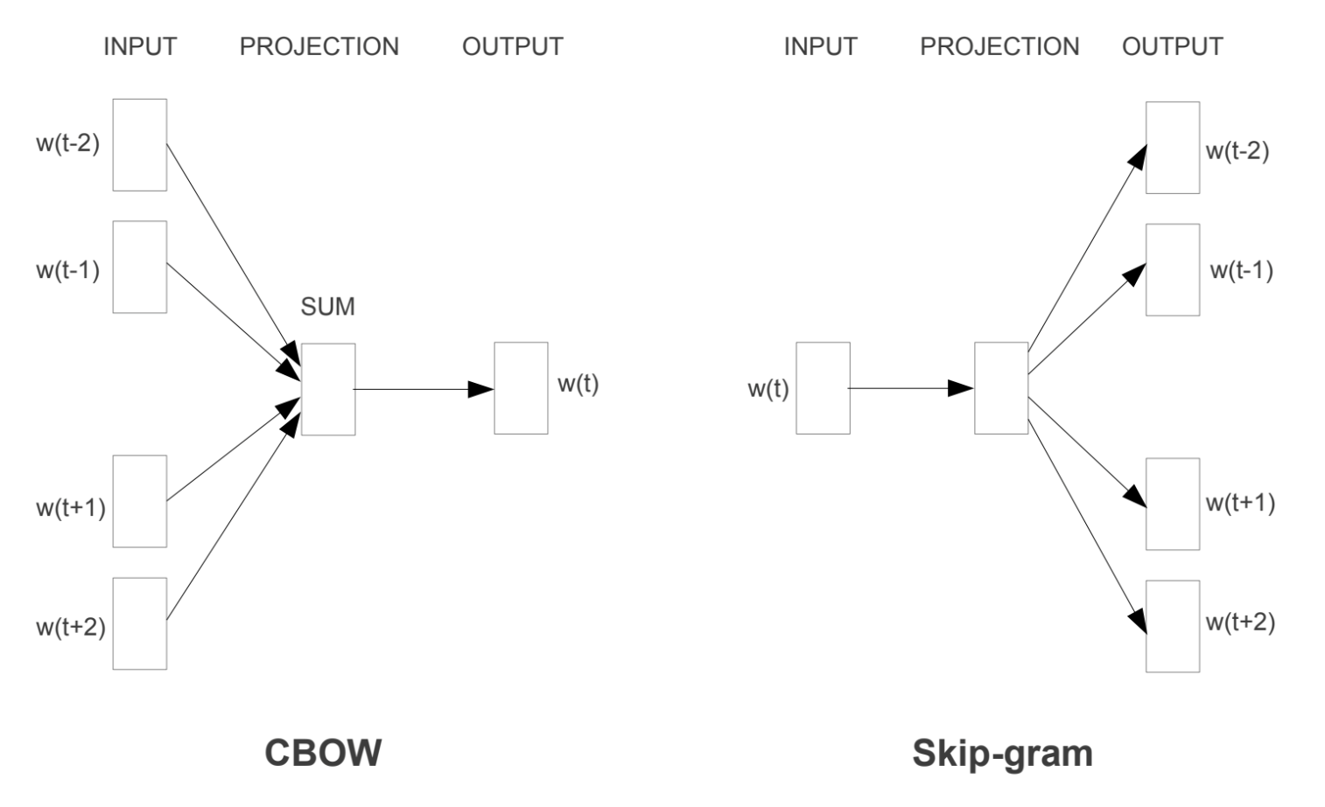
Word Embeddings You are known by the company you keep
Each word is represented by a point in the embedding space – A vector
Why do we need them: To capture the context from similar words
Have a good day vs Have a great day
How does Word2Vec work?
Skip Gram
Common Bag Of Words (CBOW)
Other Embedding Models
GloVe
ELMO
BERT
Transformers
Flair
Many more….
Learn from scratch: Check this Tutorial

Slide 6
NLP - Downstream tasks 347 leader boards • 205 tasks • 100 datasets • 2605 papers with code
Refer to paperswithcode.com to see the list of all NLP tasks and respective papers with leader board
Question Answering
Language Modelling
Sentiment Analysis
Text Classification
Named Entity Recognition
Sentence Embeddings
Tokenization

Slide 7

Assignment
Group 1
Name
Team Member 1
Team Member 2
Team Member 3
Team Member 4
Group 2
Name
Team Member 1
Team Member 2
Team Member 3
Team Member 4
Group 3
Name
Team Member 1
Team Member 2
Team Member 3
Team Member 4

